Slide 1

CASE STUDY
Cylistic Bike-Share

Slide 2
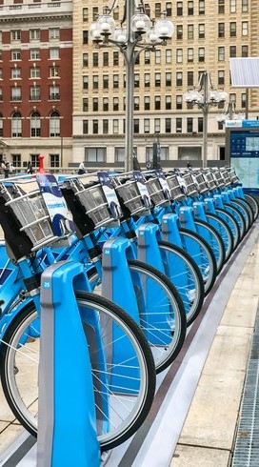
Contents
Introduction
Data insights
Summary
Recommendations
Appendix

Slide 3
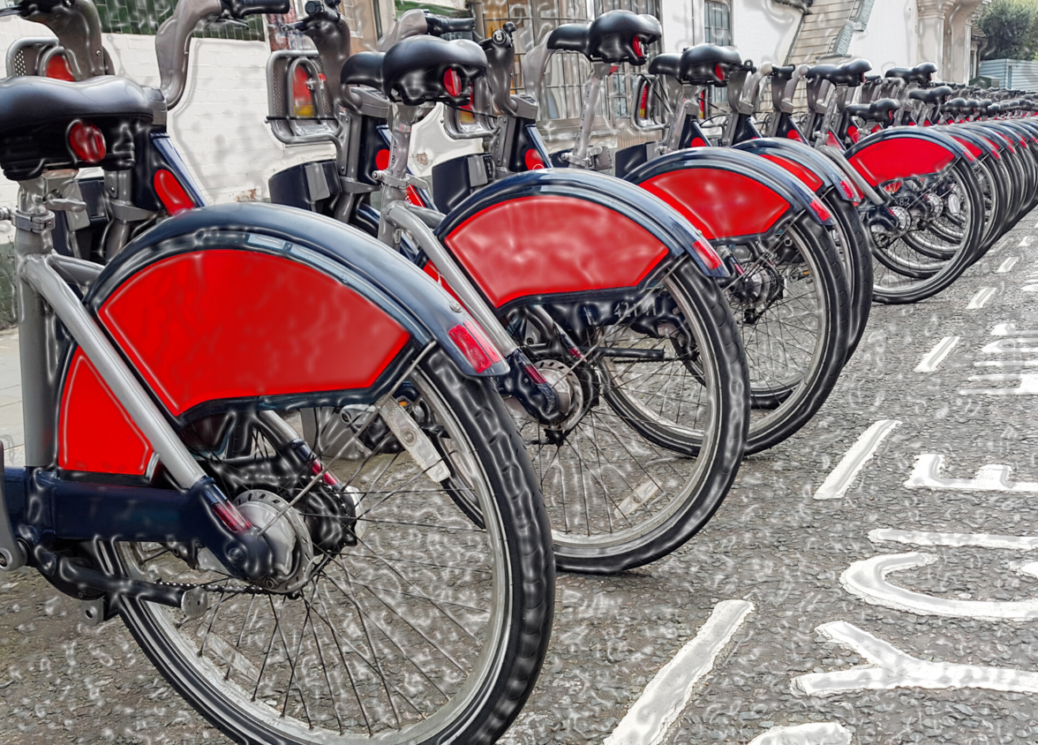
Statement of Business Task
Understand how annual members and casual riders use cyclistic bikes differently.
This comparison along with other tasks will be later used to design marketing strategies aimed at converting casual riders into members.

Slide 4

Insights From Last 12 Months October, 2021 to September, 2022

Slide 5
Total Ride Share of Each User Group
Insight #1
Number of rides taken by Members is 18% more than rides taken by Casual users.

Slide 6
Average Duration of Rides
Average ride duration of Casual riders is more than 2 times Member riders

Slide 7
Weekly Breakdown of Number of Riders
Insight #2
The number of casual riders get almost doubled on weekends compared to weekdays.
The number of Member riders increases early on weekdays, and drops steadily from mid-week till weekends.

Slide 8
Weekly Breakdown of Average Ride Duration
Insight #3
Members average ride duration remains constant throughout the week
The average rides duration for casual riders fluctuates during the week.

Slide 9
Casual Riders Weekday vs Weekend
The average ride duration of casual users does not change at the same rate as the number of rides.
Still, There’s a moderately positive correlation.
It shows weekend casual riders tend to take longer rides than weekday users.

Slide 10
Annual Breakdown of Average Ride Duration
Insight #4
Average ride duration of casual riders increase and hits its peak on May and Sept

Slide 11

INSIGHTS
SUMMARY

Slide 12
Summary
Casual riders mostly use bikes for recreational purposes
Unlike members who have consistent activity throughout the year, casual rider’s use of bikes on weekends and holidays suggests they use them for recreational purposes
Casual riders take longest rides on the months of April, May, and Sept
On Its peak on May, average ride duration of casual riders is 2x more than Members
Overall, Casual riders take less number of rides but for longer durations
Casual users takes 18% less rides than Members but for 2x longer duration.
Casual Riders are most active on Weekends (1.8x) and tend to take longer rides
15,352 increase in number of rides and 9min increase on average duration of rides during weekends

Slide 13
Recommendations
Now that we know how Casual users use bikeshare differently, we can:
Design riding packages by keeping recreational activities, weekend contests, and summer events in mind as more casual riders are inclined towards it.
If customers are charged on duration basis, offer specialized discounts and coupons for regular and substantial users, This way users will be encouraged for more longer rides and thus it results in high revenue.
Design seasonal packages, It allows flexibility and encourages casual riders to get membership for specific periods they want rather than paying for annual subscription.
Effective and efficient promotions by targeting casual riders at the busiest times and stations
Days: Weekends
Months: April, May, and Sept
Stations: Streeter Dr & Grand Ave, DuSable Lake Shore Dr & North Blvd, Millennium Park

Slide 14
THANK YOU
Diamond Dada
diamondseminence@gmail.com
Github.com/diamondeminence

Slide 15
APPENDIX

Slide 16
Datasets
Data used for this analysis is a sample of datasets made available by Motivate International Inc. on https://divvy-tripdata.s3.amazonaws.com/index.html under this license, https://ride.divvybikes.com/data-license-agreement
We are 99.99% confident that the result obtained from the sample is true for the complete dataset (4,073,561 observations) with 0.2 margin of error.
Top 5 Stations used by Casual Users in last slide

Slide 17
Top 5 Stations Used by Casual Riders

